Slide 1
CGB1201 – JAVA PROGRAMMING PROJECT REVIEW-2
Department of Computer Science and Engineering
Academic Year: 2024 – 2025 (Odd Semester)
Register Number :8115U23AM055
Name :K.THULASINATH
Year :2nd
Semester :3rd
Department :Cse-Aiml
Date :5/12/2024

Slide 2
Title of the Project
Event Scheduling System
A practical guide to streamlining event management with Java programming

Slide 3
Abstract
The Event Scheduling System is a Java-based application designed to simplify organizing and managing events efficiently. It enables users to create, update, and delete events while preventing scheduling conflicts through intelligent algorithms. Features like automated notifications, role-based access, and calendar integration enhance user convenience. Built using Java Swing/JavaFX, MySQL, and APIs, the system ensures scalability and reliability. This tool is ideal for personal, academic, and corporate event management, improving coordination and reducing errors.

Slide 4
Abstract with CO/PO Mapping
Abstract | CO | POs | PSO
Apply object-oriented programming concepts to solve real-world problems Use modern tools to enhance professional practice in engineering. | CO3 | PO5

Slide 5
Introduction
Event scheduling is the process of planning and organizing events by assigning specific dates, times, and resources. It ensures efficient coordination among participants and avoids conflicts through structured planning. Modern systems leverage technology to automate scheduling, send reminders, and manage resources effectively. These tools are widely used in personal, academic, and corporate settings to streamline event management. A well-designed scheduling system enhances productivity and ensures seamless event execution.

Slide 6
Java Programming - Concepts Used
Object-Oriented Programming (OOP): Facilitates modular design through classes like Event, User, and Scheduler, ensuring scalability and reusability.
Java Collections Framework: Efficiently manages data structures like lists and maps to handle event details and user data.
Swing/JavaFX: Provides a user-friendly graphical interface for scheduling and managing events.
JDBC (Java Database Connectivity): Connects the system to a database for storing and retrieving event-related information persistently.
Exception Handling: Ensures smooth operation by managing errors like invalid inputs or scheduling conflicts.

Slide 7
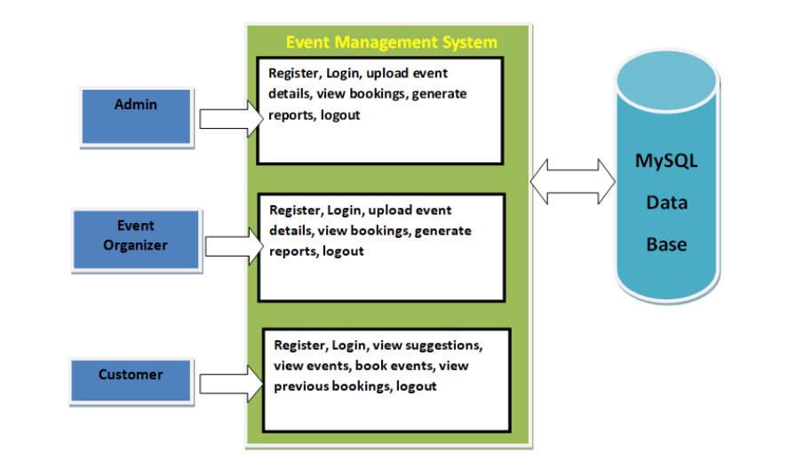
Proposed Architecture

Slide 8
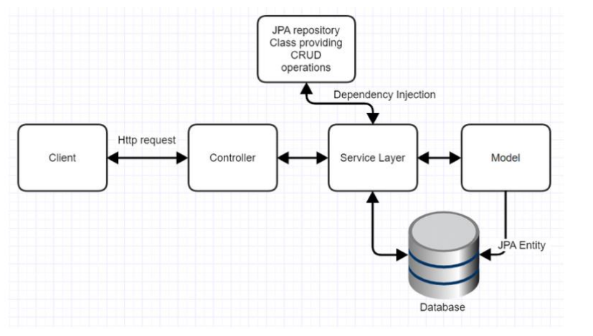
Technical Architecture

Slide 9
Proposed Architecture - Description
The proposed architecture of the Event Scheduling System follows a
client-server model, with the client (Java Swing/JavaFX) communicating with the
server to handle event management tasks. It uses a layered architecture (MVC)
to separate data management (Model), user interface (View), and user interactions
(Controller) for better organization. JDBC integration ensures seamless
communication between the system and a relational database (e.g., MySQL)
for persistent data storage. This structure improves maintainability, scalability,
and performance. The system is designed for efficient scheduling, conflict
resolution, and user interaction.

Slide 10
List of Modules
User Authentication and Authorization: Manages login, registration, and
role-based access control for different users.
Event Creation and Management: Enables users to create, update, and manage
events with essential details.
Scheduling and Conflict Resolution: Detects scheduling conflicts and suggests
alternatives to avoid overlaps.
Notifications and Alerts: Sends timely reminders and updates to users about
events and changes.
Database Management: Stores event, user, and scheduling data in a relational
database for persistent access.

Slide 11
Module Description
Event Creation and Management: Allows users to create, update, and manage event details such as time, date, location, and participants.
Scheduling and Conflict Resolution: Automatically detects and resolves scheduling conflicts, optimizing event times and resources..
Notifications and Alerts: Sends automated reminders and updates to users about event changes and upcoming activities.

Slide 12
Results and Discussion
Improved Event Management Efficiency: The system automates event creation, scheduling, and conflict resolution, significantly reducing manual errors and time spent on scheduling tasks.
Enhanced User Experience: The intuitive GUI and timely notifications ensure a smooth and efficient user experience, making event management accessible to a wide range of users.
Scalability and Performance: The database integration supports efficient handling of large datasets, ensuring the system can scale to accommodate both small and large event management needs.

Slide 13
Results and Discussion (Cont..)
Conflict Detection and Resolution: The system effectively identifies scheduling conflicts and suggests alternative time slots, ensuring better resource utilization and smoother event coordination. This feature is particularly beneficial in environments with multiple overlapping events or limited resources.
Database Reliability: The system’s integration with a relational database (MySQL) ensures data integrity, persistent storage, and reliable access to event and user information. It also allows for easy backup and recovery, safeguarding against data loss.

Slide 14
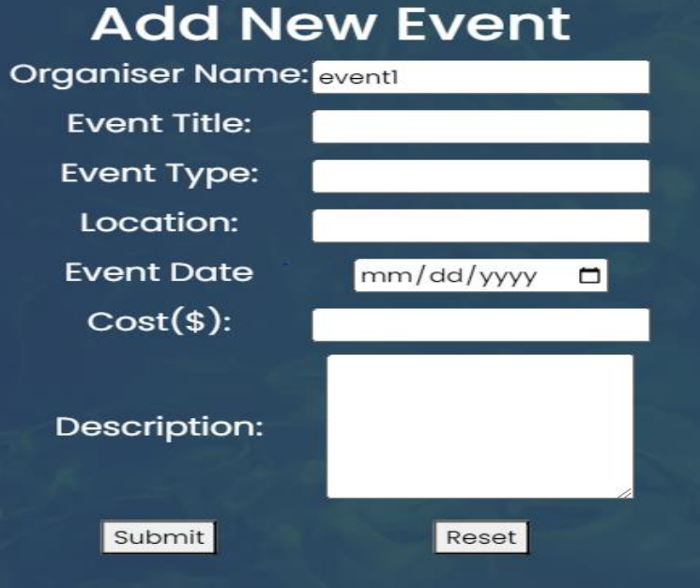
Result(Screenshot)

Slide 15

Admin view Bookings page

Slide 16
Conclusion
The Event Scheduling System effectively automates event management, improving efficiency and reducing errors. It uses Java frameworks and database integration to ensure reliable scheduling and data management. The system's intuitive interface and real-time notifications enhance user experience and accessibility. Conflict resolution features help optimize resource usage and prevent overlaps. Future improvements, such as AI-based scheduling and mobile integration, can further optimize functionality. Overall, the system is scalable and adaptable, making it suitable for a variety of event management needs.

Slide 17
Thank You

